Slide 2
„ Introducing e.CO App‘‘

Slide 3


Slide 4

The Homescreen gives a simple overview for all functions
e.GO-Logo gives a link to e.GO-Homepage
Gamification
Navigation
Statistics
Settings
Car-status

Slide 5
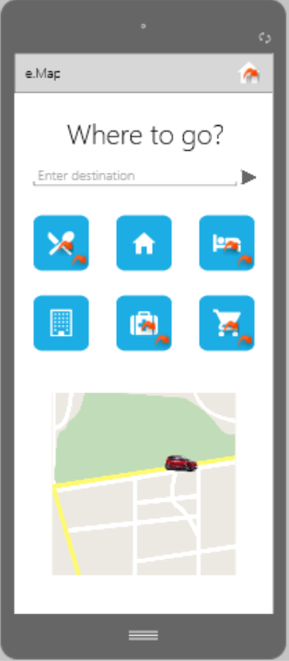
Navigation in a new thought User Interface
Set your destination – only Mockup
Get something to eat
“Bring me home“-Function – only Mockup
Get a hotel
“Bring me to work” – only Mockup
Closest hospital
Grocery shopping

Slide 6
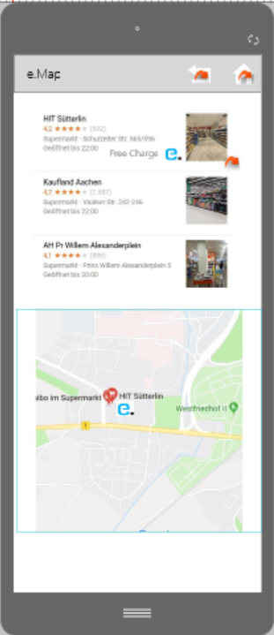
Example functions of grocery shopping function
In this Mockup-App, you are limited to go to the HIT-supermarket. Try what’s happening when clicking on it. Future concepts will of course contain a wider selection range.

Slide 7
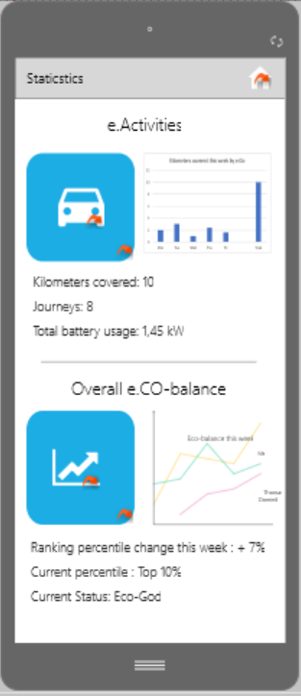
The statistics function allows you to visualize Gamification and health data
You get a clear overview on your e-Activities such as how many kilometers you travelled with e.CO mobility this week. For more detailed information click on the blue icon. Furthermore you can visualize how environmentally friendly you have been driving your car in direct comparison with your friends. For more information, such as data in a longer time span, click on the blue icon with the arrow.

Slide 8
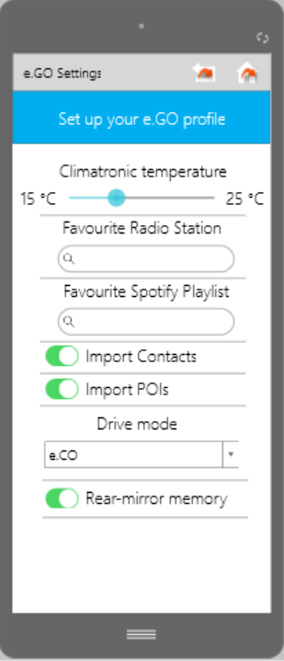
Your e.GO profile allows you to have an induviduialized experience in any e.GO car
You are able to choose software preferences such as the temperature whilst driving or your favorite radio station or spotify playlist. Additionally, you can can also make sure that every e.GO quickly adjusts to how you choose to install the physical aspects of your car such as the mirrors.

Slide 9
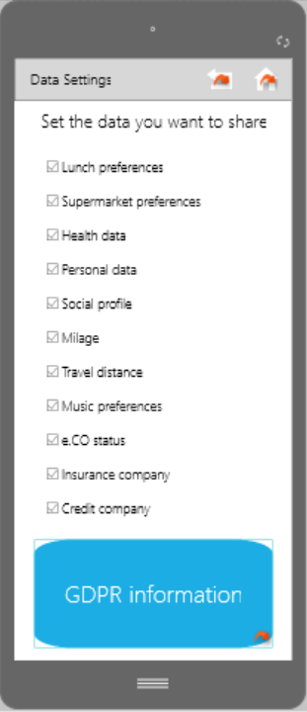
The e.GO app can track your preferences and use this information to e.GOs and your own advantage –if you want
Each customer can choose whether they want to share their personal preferences with e.GO. e.GO can use this data to further optimize the travel experience by giving personalized suggestions or sell on the data to third parties.

Slide 10
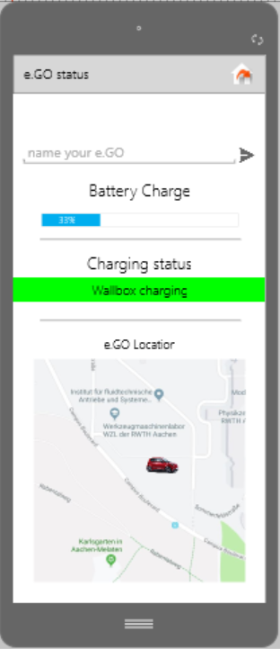
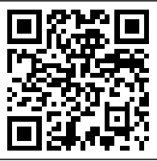

The e.Go app automatically tracks real time information about e.GO cars nearby
There’s way more functions – Just try them out
iOS
Android
Make sure to be logged in into “Hackathon”-WiFi

